Slide 1
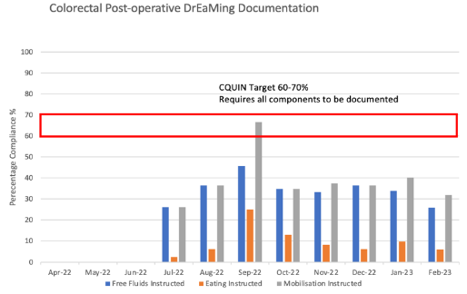
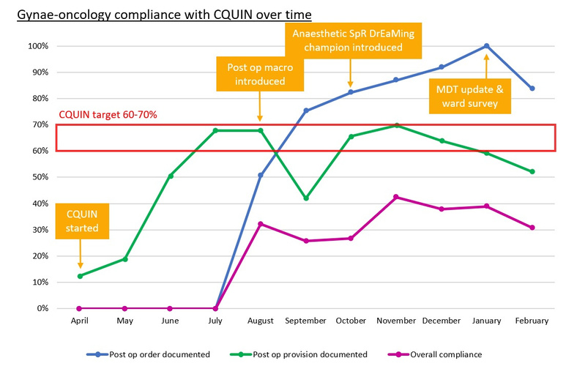
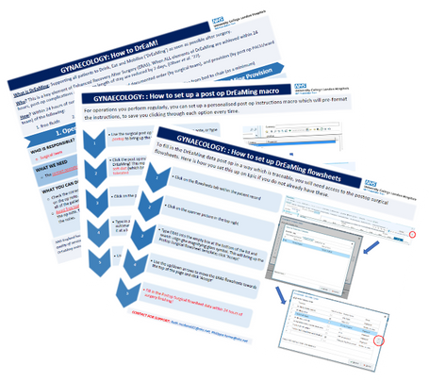
Introduction
Results
Collaborating to DrEaM bigger and better
Dr Philippa Horne and Dr Rachael Brooks, Anaesthetic Registrars
Dr Melanie Tan, Consultant Anaesthetist
Ruth McDonald, CNS Gynaecology
University College London Hospital
The challenges in using digital data to drive quality improvement in clinical practice
Ward Themes from Survey
Barriers to DrEaming
Supporting patients to Drink, Eat and Mobilise (DrEaMing) within 24-hours of major surgery is associated with reduced length of stay and late complications¹. DrEaMing was assigned a financial incentive through the NHS England CQUIN scheme in 2022². Achieving the CQUIN requires surgical andl DrEaMing provision documentation in over 60% of cases. Beyond the CQUIN, UCLH wanted to deliver DrEaMing to all patients and embed a culture change, reinvigorating core concepts of enhanced recovery pathways.
Optimal use of UCLH's electronic healthcare record, EPIC, was key to our culture change strategy. New digitally built DrEaMing CQUIN tools in EPIC aimed to replace arduous note trawling for CQUIN compliance with an easy to extract dataset for all surgical specialties. Providing surgical teams with this sustainable real-time DrEaMing data aimed to drive local quality improvement (QI) and underpin future enhanced recovery initiatives.
Figure 3. Colorectal ward provision documentation of DrEaMing. Eating element in colorectal globally poorly documented due to multiple challenges
-Unclear surgical instructions in ward round entry or operation note
Variation in surgical postoperative plans
-Lack of time to document or time to help patients DrEaM
-Duplication of documentation on EPIC or forget to document in the correct place on flowsheets
CQUIN data from EPIC across 2022-23 showed variable CQUIN compliance across specialties, with compliance significantly higher when extracted manually via a note trawl.
Gynae-oncology (n=354, Figure 2) postoperative surgical documentation initially improved whilst provision plateaued.
Benign gynaecology (n=295) failed to reach the CQUIN threshold for any indicator.
Colorectal (n=471) CQUIN
-Difficulties accessing devices to document DrEaMing
55% complete documentation on paper until can find a free device
>90% would like more portable devices with flowsheets
Methods to collaboratively deliver DrEaMing
Ward Improvement suggestions
-Surgical team engagement
Highlight importance of post op instructions
Cohesive team communication and approach to postoperative eating
-Ward staff engagement
Regular staff training on DrEaMing to highlight its importance for patients
Add DrEaMing into vital signs rounds
Staff incentives: ‘DrEaMer of the month’
-Improve ease of documentation and add post-op documentation onto available portable devices
compliance was limited by poor documentation of postop Eating instructions (Figure 3) and subsequent
poor ward Eating provision, possibly reflecting the heterogenous and tertiary nature of colorectal
procedures undertaken, which limits the team implementing a blanket postoperative eating plan.
Discussion
A multipronged, collaborative approach occurred across all CQUIN surgical specialties in parallel. Anaesthetics trainee leads worked alongside surgical teams' Clinical Nurse Specialists (CNS) to facilitate collaborative working with the perioperative team, conveying DrEaMing data findings and supporting the CNS in leading DrEaMing related change.
Surveys of 26 ward staff across women’s health and colorectal surgery revealed barriers to ward
documentation of DrEaMing provision (see speech bubbles).
Digitally built DrEaMing CQUIN tools were developed to facilitate easy extraction of CQUIN metrics: a Postoperative surgical instruction tool and a Postoperative DrEaMing ward provision “flowsheet” were co-developed with nursing teams.
DrEaMing CQUIN compliance using EPIC data extraction at UCLH remains poor, despite motivated staff and a culture of QI. Compliance was significantly higher with manual notes trawl highlighting disparity between clinical practice and use of new EPIC builds. Our aim to make DrEaMing data easily accessible for QI requires further buy-in from surgical teams and engagement with ward staff. Permanent CNS act as pivotal change champions, mitigating barriers to DrEaMing and documentation on the ward through education and awareness.
Future plans lie in a co-designed approach with the CNS’ to increase team engagement, facilitating ward staff education and celebrating monthly “top DrEaMers” who consistently document DrEaMing.
Key stakeholders involved in the provision of DrEaMing on surgical wards were surveyed to ascertain barriers to DrEaMing. Results were disseminated across the perioperative and nursing leadership to foster further improvements, whilst extraction of CQUIN data from EPIC continued throughout the year to drive further QI.
Figure 2: Gynae-oncology CQUIN compliance April 2022 - February 2023 with timepoints for QI interventions
Figure 1. 'How to' guides for new macros and smartphrases for postop surgical note, to facilitate extractable CQUIN data on EPIC
Oliver et al. (2022) BJA, 129(1), 114–126.
NHSE CQUIN annex indicator specifications 2022/2023. Accessed 17/03/23 https://www.england.nhs.uk/wp-content/uploads/2022/01/B1477_ii_commissioning-for-quality-and-innovation-scheme-for-2022-23-v1-4-201022.pdf

